Slide 1
THIRD EYE FOR BLIND
GOGGLES
STICK

Slide 2
STICK
MATERIAL USED:-
Arduino UNO R3 ATmega16U2 ATmega328 (DIP)
Stick
HC-SR04 Ultrasonic Sensor
Jumper Wires
DC Buzzer
Battery Connector
9V Battery
Cable Tie Clips
Soldering Iron
Soldering Wax

Slide 3
PROCEDURE :-
Take a PVC Pipe(rod), then with the help of Cable Tie Clips attach the Sensor to the rod.
Now, after coding the Arduino Motor attach it also to the rod.
Connect the Jumper wires to the sensor.
Connect: sensor’s VCC to 5V; sensor’s GND to GND; echo to arduino pin(10); trig to arduino pin(9).
Connect 3V DC Buzzer’s Negative end to GND & Positive to arduino pin(11).
Connect LED to arduino pin(13) & GND.
Now, join the 9V Battery with the Arduino.

Slide 4

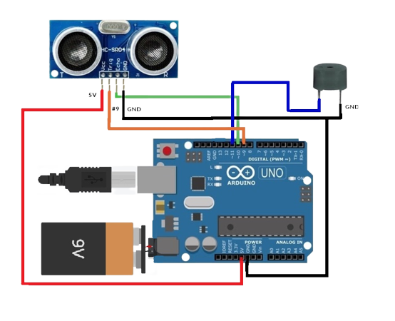
CIRCUIT DIAGRAM :-

Slide 5
GOGGLES
MATERIAL USED:-
Arduino NANO
Ultrasonic sensor – 1
On / off switch
Buzzer – 2
Battery
Safety goggles
Wires
Jumper cables

Slide 6
PROCEDURE :-
Fix ultrasonic sensor on the centre of the goggle.
Attach battery to one side of the goggle.
Connect vibration motor and buzzer on both sides.
Put the switch and Arduino on the battery.
Connect the wires.

Slide 7
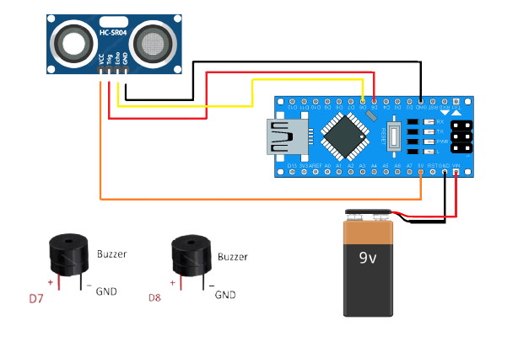
CIRCUIT DIAGRAM :-

Slide 8
Advantages
Measure the distance and alert the blind people.
Can tell about obstacle more precisely than conventional blind stick
It is simple to use and is affordable.
Smart blind stick is robust and the stick is light, portable and reliable.
It consumes low power which makes it feasible to use.

Slide 9
The Purpose
Currently there are thousands of blind people all over the globe. These include people from low sight seeing to complete lost of visual.
They find it very difficult while crossing the road or reaching to their respective destination with the help any other individual.
The traditional stick cannot help to detect the obstacles in front or the potholes in the way. It is outdated. Hence there is a need to update it using today's technology

Slide 10
The Technology
The smart stick for the blind as the name suggests is a device for the visually impaired to guide the user to respective destination and avoiding to collide with the obstacles. It uses ultrasonic sensors HC SR 04 to detect the depth below or the obstacles in between.
Along with that it uses Arduino as the main controller. The sensor will detect the distance from the obstacle and send to the controller. The controller will then convert in audio format.

Slide 11
CONCLUSION
It is worth mentioning at this point that the aim of the of this study is design and implementation of a smart walking stick for the blind has been fully achieved .
The smart stick as a basic platform for the coming generation of more adding devices to help the visually impaired to navigate safely both indoor and outdoor.
It is effective and affordable. It leads the good result in detecting the obstacles on the path of the user in a range. This project offer low cost, reliable, portable, low power consumption and robust technology for navigation with short response time.

Slide 12
GROUP MEMBERS
TAMANNA SINGHAL
SARA AMIT THAKUR
NITIGYA ASWANI
JATIN SINGH
LUCKY YADAV

Slide 13


